Slide 1


Exploratory Data Analysis and Machine Learning on New York City Airbnb Dataset
Course: CS-661 Python Programming
Professor: Kshitij Sharma
Team: Group 1
Shridhi Patel – U02007154
Krushi Patel – U02007786
Ansh Kevadiya – U02007203
Smit Meghapara – U02007203
Lakshmi Nadella – U01950459
Notes:
To change the image on this slide, select the picture and delete it. Then click the Pictures icon in the placeholder to insert your own image.

Slide 2

Project Overview
Abstract
Introduction
Dataset
Preprocessing
Literature Review
Architecture/Methodology
Results
Machine Learning Techniques
Conclusion
References
GitHub Repository for Code

Slide 3

Abstract
This project performs an Exploratory Data Analysis (EDA) on the New York City Airbnb Open Data dataset to examine patterns in pricing, availability, room types, and neighborhoods. The dataset is cleaned and analyzed using Python to identify key trends and relationships.
Additionally, machine learning models including Linear Regression, Decision Tree, and Random Forest are applied to predict Airbnb prices and evaluate feature impact. The study provides data-driven insights into factors influencing Airbnb pricing in New York City

Slide 4

Introduction
Hola! I am Ansh
Hi! I am Shridhi
Hi! I am Lakshmi
Hi! I am Smit
The New York City Airbnb Open Data dataset provides insights into short-term rental listings across New York City. This analysis focuses on understanding how different listing attributes influence pricing and availability using data-driven techniques.
Key objectives:
Analyze Airbnb pricing patterns
Examine room types and neighborhood trends
Study availability and host activity
Predict prices using machine learning models
Hi! I am Krushi

Slide 5


Dataset
The dataset used in this project is the New York City Airbnb Open Data, sourced from Kaggle (https://www.kaggle.com/datasets/dgomonov/new-york-city-airbnb-open-data).
A cleaned and preprocessed version of the dataset was used for analysis, containing information about Airbnb listings, including price, location, room type, availability, and host-related features across New York City.
New York City Airbnb Open Data

Slide 6
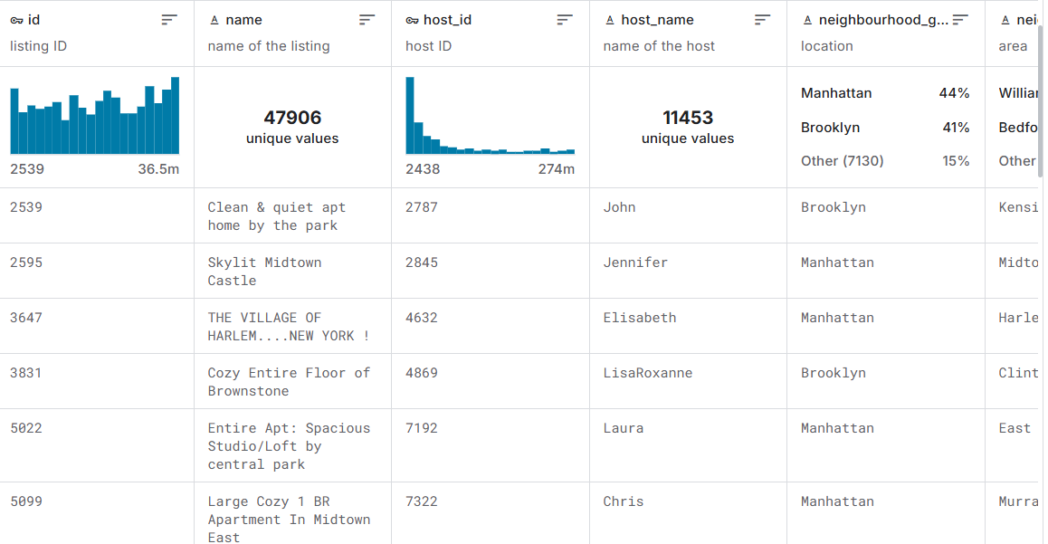
Dataset Description
48,895 records of Airbnb listings in New York City
16 attributes, including price, neighborhood, room type, availability, and host information
Covers listings across all five NYC boroughs
Includes both raw and cleaned versions for preprocessing and analysis
Suitable for analyzing pricing trends, availability patterns, and location-based insights

Slide 7

Understanding the Data
Structure
Each record represents a single Airbnb listing with location, pricing, and availability details
Data is structured at the listing level, enabling comparison across neighborhoods and room types
Metadata Highlights
Includes critical attributes such as price, room type, minimum nights, availability, and number of reviews
Neighborhood and borough information supports spatial and geographic analysis
Analytical Value
Enables identification of pricing disparities across locations
Supports analysis of demand patterns using availability and review activity
Provides a strong foundation for predictive modeling of Airbnb prices

Slide 8
Data Preprocessing
Handling Missing Values
Removing Duplicates
01
02
Missing values in columns such as price, reviews per month, and availability were identified and handled to ensure data consistency.
Duplicate listings were checked and removed to avoid bias and maintain dataset accuracy
Data Preprocessing
Standardizing Text Fields
03
04
Converting Data Types
Text fields like room type, neighborhood, and borough were standardized for uniform analysis.
Columns such as price, minimum nights, and availability were converted to appropriate numeric formats.
05
06
Handling Outliers
Final Cleaned Dataset
Extreme values in price were capped or filtered to reduce skewness and improve model performance.
A final cleaned dataset was prepared and used for EDA and machine learning modeling.

Slide 9

Pricing on Airbnb is influenced by location and room type
Neighborhood-level analysis reveals demand variations
EDA is widely used to identify pricing trends
Machine learning models improve price prediction accuracy
Combining EDA and ML enhances insight quality

Slide 10

Architecture/Methodology
01 — Importing Libraries
02 — Loading the Dataset
03 — Initial Data Inspection
04 — Data Preprocessing
Python libraries loaded
Airbnb NYC CSV loaded
Data structure reviewed
Missing values handled
08 — Final Visualization Output
07 — Insight Extraction
06 — Exploratory Data Analysis
05 — Feature Formatting
Results presented
Key trends interpreted
Visual patterns examined.
Columns standardized for analysis.

Slide 11

Exploratory Data Analysis

Slide 12
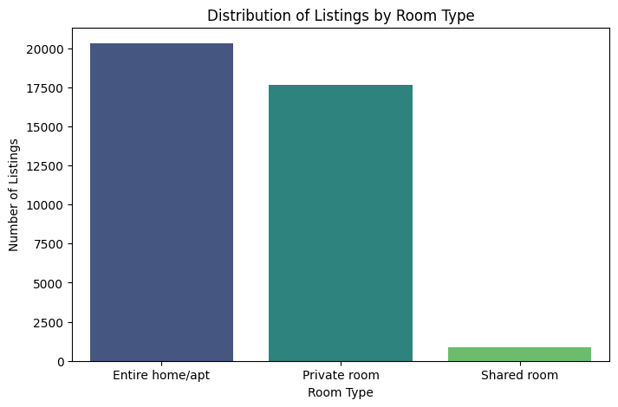
Distribution of Listings by Room Type
Entire homes dominate Airbnb listings
Shared rooms are minimal

Slide 13
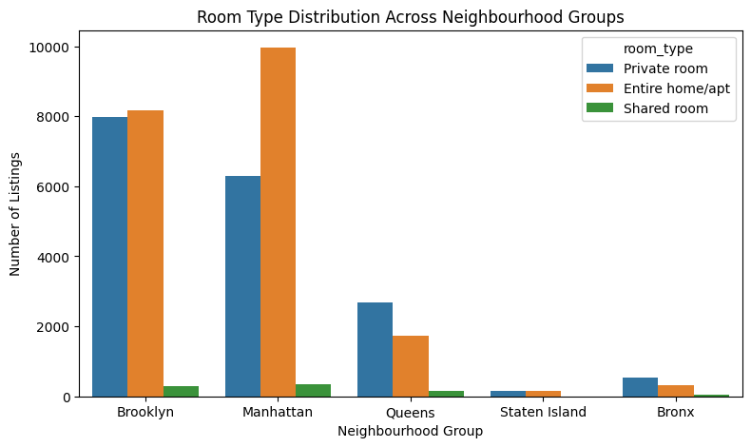
Room Type Distribution Across Neighborhoods
Manhattan has the highest number of entire homes
Brooklyn has high private rooms + entire homes
Queens, Bronx, Staten Island are much lower overall

Slide 14
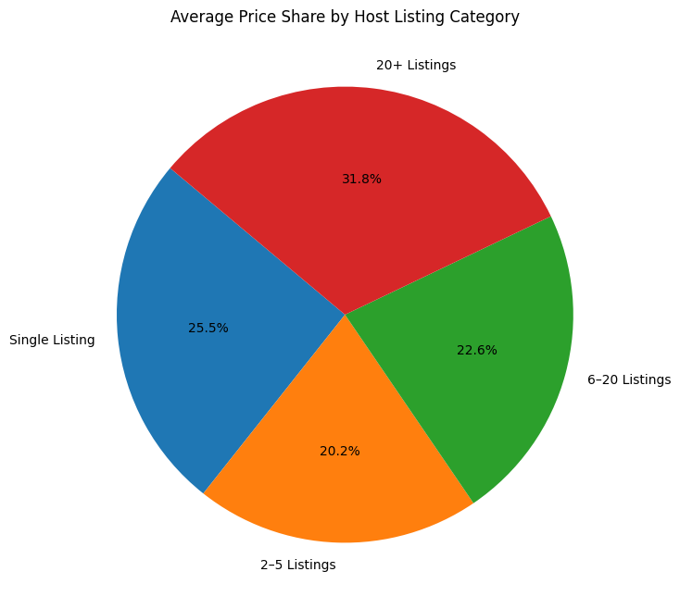
Average Price Share by Host Listing Category
Hosts with 20+ listings account for the largest share of average prices.
Single-listing hosts contribute a smaller share, indicating lower pricing power

Slide 15
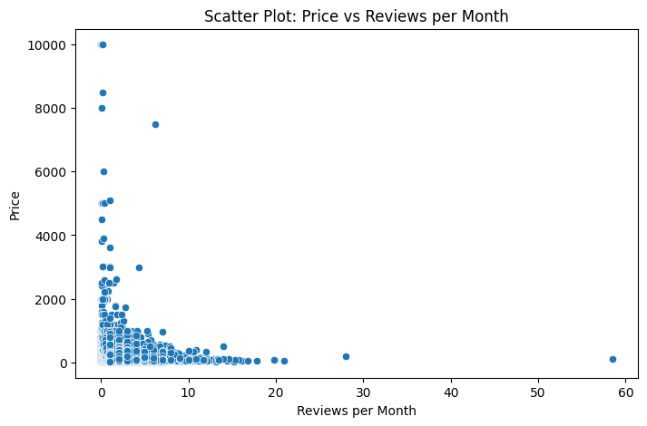
Price vs Reviews per Month
Listings with more reviews per month tend to have lower prices
High-priced listings receive fewer monthly reviews

Slide 16
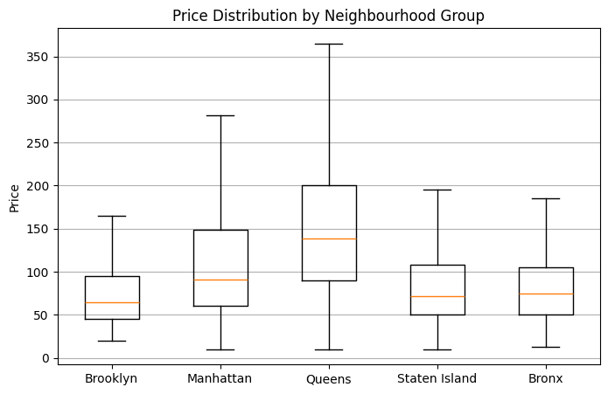
Price Distribution by Neighborhood Group
Manhattan and Queens show higher price ranges
Brooklyn, Bronx, and Staten Island have lower median prices

Slide 17
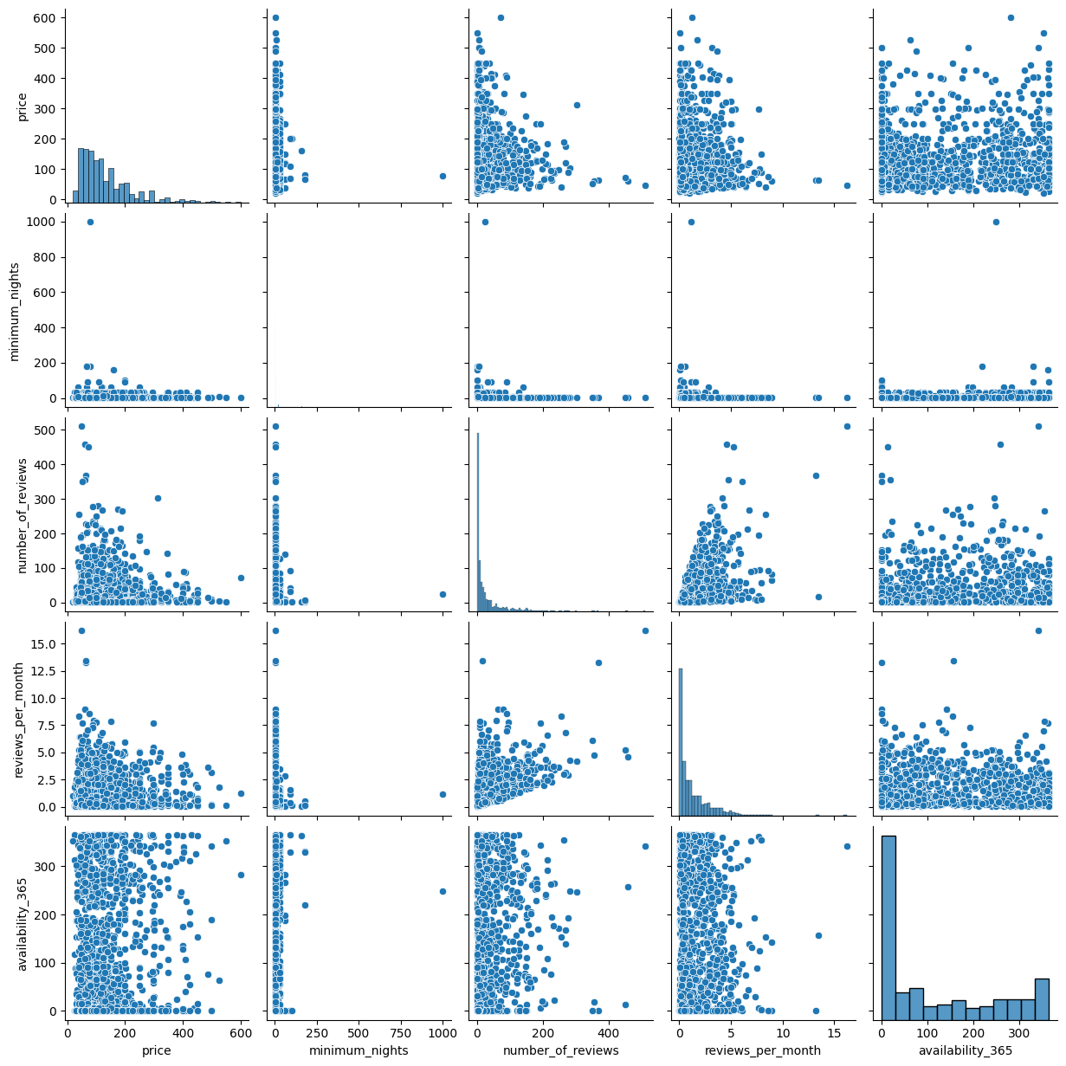
Pairwise Relationships Between Key Numerical Features
Price shows weak correlation with reviews and availability
Most listings cluster at lower prices and lower minimum nights

Slide 18
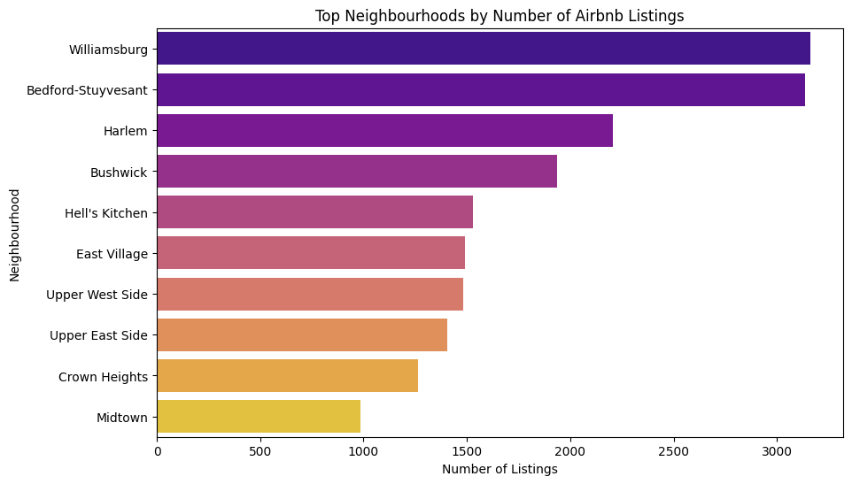
Top Neighborhoods by Number of Airbnb Listings
Williamsburg and Bedford-Stuyvesant have the highest number of listings
Airbnb listings are concentrated in popular urban neighborhoods

Slide 19
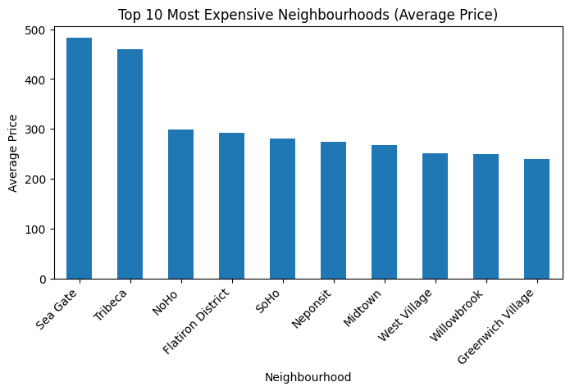
Top 10 Most Expensive Neighborhoods (Average Price)
Sea Gate and Tribeca have the highest average Airbnb prices
Premium neighborhoods show significantly higher pricing levels

Slide 20
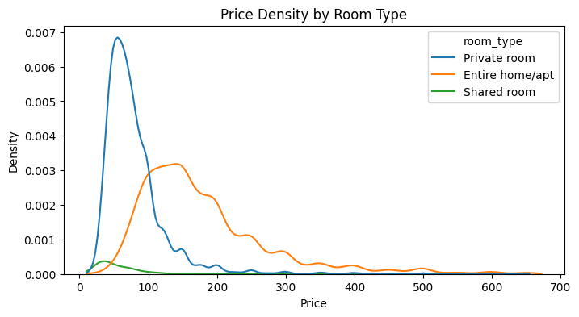
Price Density by Room Type
Entire homes/apartments have higher and wider price distributions
Private and shared rooms are concentrated at lower price ranges

Slide 21
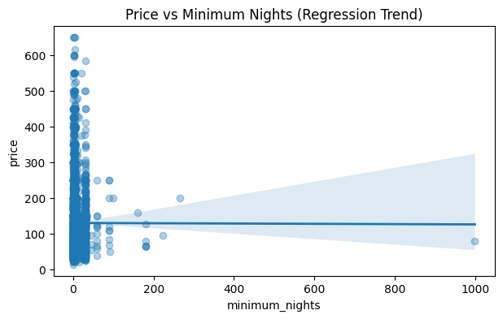
Price vs Minimum Nights
Price shows little change as minimum nights increase
Most listings require low minimum stays, regardless of price

Slide 22
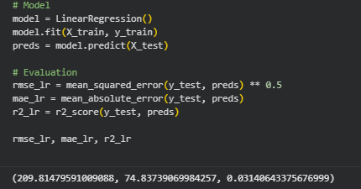
Machine Learning Model: Linear Regression
Price vs Minimum Nights
Model Purpose
Used to predict Airbnb listing prices
Serves as a baseline regression model
Input Features
Numerical features only (e.g., minimum nights, reviews, availability)
Train–Test Split
80% training, 20% testing
Evaluation Metrics
RMSE: ~209
MAE: ~75
R² Score: ~0.03
Key Insight
Linear Regression shows low prediction accuracy
Airbnb pricing is non-linear, requiring advanced models

Slide 23
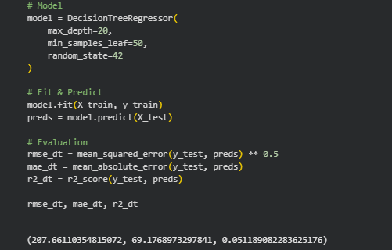
Machine Learning Model: Decision Tree Regression
Price vs Minimum Nights
Model Purpose
Used to capture non-linear relationships in Airbnb pricing
Improves prediction compared to Linear Regression
Model Configuration
Max depth: 20
Minimum samples per leaf: 50
Controls overfitting and improves generalization
Train–Test Split
80% training, 20% testing
Evaluation Metrics
RMSE: ~207.7
MAE: ~69.2
R² Score: ~0.05
Key Insight
Decision Tree performs better than Linear Regression
Able to model complex pricing patterns, but still limited

Slide 24
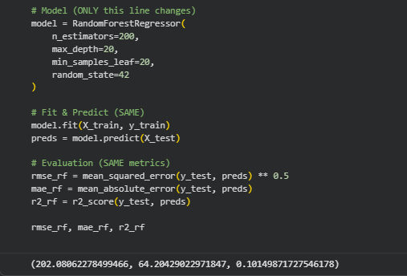
Machine Learning Model: Random Forest Regression
Price vs Minimum Nights
Model Purpose
Ensemble model used to improve price prediction accuracy
Combines multiple decision trees for better generalization
Model Configuration
Number of trees: 200
Max depth: 20
Minimum samples per leaf: 20
Train–Test Split
80% training, 20% testing
Evaluation Metrics
RMSE: ~202.1
MAE: ~64.2
R² Score: ~0.10
Key Insight
Random Forest provides the best performance among all models
Captures complex and non-linear pricing patterns effectively

Slide 25

Listing Distribution
Entire homes are the most common listing type
Pricing Trends
Prices vary significantly across neighborhoods
Location Insights
Manhattan and Brooklyn show higher pricing levels
Demand Patterns
Lower-priced listings receive more frequent bookings
Machine Learning Performance
Random Forest provides the most accurate price predictions
Notes:
“So, summarizing our key findings:
• In terms of content distribution, movies form the majority of Netflix’s catalog. • For genre trends, we observed that dramas, comedies, and international content appear the most. • Looking at release patterns, the dataset shows a major spike in titles released after 2010 — reflecting Netflix’s rapid growth and investment in new content. • In rating insights, we saw that TV-MA and TV-14 dominate, meaning Netflix focuses heavily on mature and young-adult audiences. • And finally, in country contribution, most titles come from the United States, India, and the United Kingdom — the top three producing regions.”

Slide 26


EDA revealed key pricing and demand patterns in NYC Airbnb listings
Location and room type strongly influence pricing behavior
Machine learning models improved understanding of price prediction
Random Forest performed best among the tested models
The analysis provides a foundation for future predictive studies
Notes:
“To conclude, this EDA helped us clearly understand how Netflix’s catalog is structured and how it has evolved over time.
The metadata — like genre, ratings, and release years — gave us a clear picture of content diversity. The visuals we created helped highlight patterns such as growth trends, content focus areas, and popular categories.
Overall, this project builds a strong foundation for more advanced analysis in the future.”

Slide 27


Recommendations / Future Work
Incorporate seasonality and booking trends to improve price prediction
Include text features such as listing descriptions and amenities
Apply clustering to identify similar neighborhoods or listing types
Use advanced models (e.g., XGBoost, Neural Networks) for better accuracy
Extend analysis by comparing Airbnb markets across different cities
Notes:
“For future work, we see a few interesting directions. First, we can analyze user viewing behavior to understand what type of content becomes popular. For example, if many viewers watch short action movies rated TV-14, Netflix can use that pattern to recommend similar titles.
Next, we can build a recommendation system using the description, genres, and country information so that users get more personalized suggestions — like recommending Korean romance shows to someone who watches that genre.
We can also apply clustering to find hidden content groups. For example, crime and suspense titles with mature ratings from different countries might naturally form one cluster.
Another extension is studying seasonal patterns — such as whether Netflix releases more titles during holidays or specific months.
And finally, we can compare Netflix with other streaming platforms to see how its content strategy differs from competitors.”

Slide 28
References
New York City Airbnb Open Data – Kaggle
https://www.kaggle.com/datasets/dgomonov/new-york-city-airbnb-open-data
Scikit-learn Documentation – Machine Learning Models
https://scikit-learn.org/stable/
Python Data Analysis Libraries (Pandas, NumPy, Matplotlib, Seaborn)
https://pandas.pydata.org/

Slide 29

Thank you

